Slide 1



POS TAGGING USING CRF
Group 32
Parth Batwara 22b2261
Saurabh Kumar 22b3905
Himanshu 22b2131
Shrikant Dighole 22b2244

Slide 2
OVERVIEW
Problem Statement
Confusion Matrix
Data Processing Info
Interpretation of confusion
Overall Performance
Comparision with HMM
Per POS performance
Reference

Slide 3
PROBLEM STATEMENT
The goal of this project is to develop a Conditional Random Field (CRF) model to predict the Part-of-Speech (POS) tag sequence for a given sentence. Using the Brown Corpus and the Universal Tag Set with 12 tags, the model is evaluated through 5-fold cross-validation.
For example, the input “The quick brown fox jumps over the lazy dog” produces the output “The/DET quick/ADJ brown/ADJ fox/NOUN jumps/VERB over/ADP the/DET lazy/ADJ dog/NOUN.”

Slide 4
DATA PROCESSING INFO
1. Tokenization: Split sentences into individual tokens (words) for analysis.
2. Lowercasing: Convert all words to lowercase to ensure uniformity.
3. Feature Extraction: Generate features for each word, including characteristics like:
• Bias term
• Lowercased word
• Last three and two characters of the word
• Checks for uppercase, title case, and digit status

Slide 5
DATA PROCESSING INFO
4. Contextual Features: Include information from neighboring words to provide context:
• Previous word features (if available)
• Next word features (if available)
5. BPE Tokenization: Utilize Byte Pair Encoding to tokenize words into subword units, allowing the model to handle rare words effectively. Features include:
• First BPE token
• Last BPE token
6. Label Extraction: Create label sets for the training data, mapping words to their corresponding POS tags.

Slide 6
OVERALL PERFROMANCE
Average Accuracy: 0.979911
Average Precision: 0.979817
Average Recall: 0.979911
Average F1-score: 0.979800
Average F0.5-score: 0.979835
Average F2-score: 0.979892

Slide 7
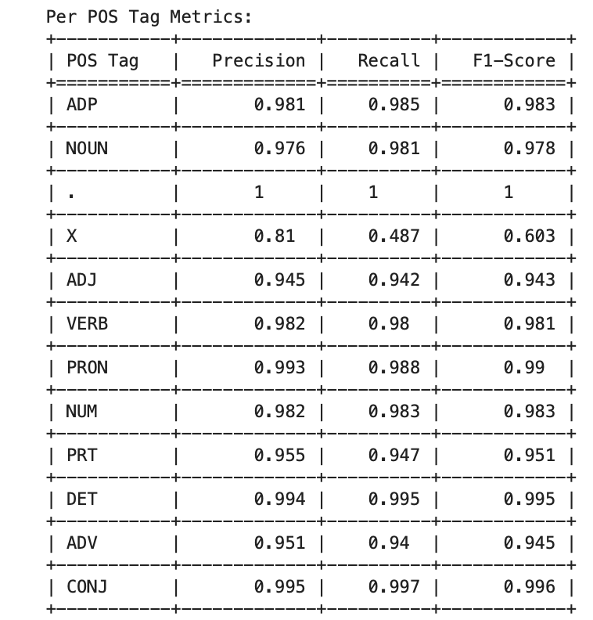
PER POS PERFORMANCE

Slide 8
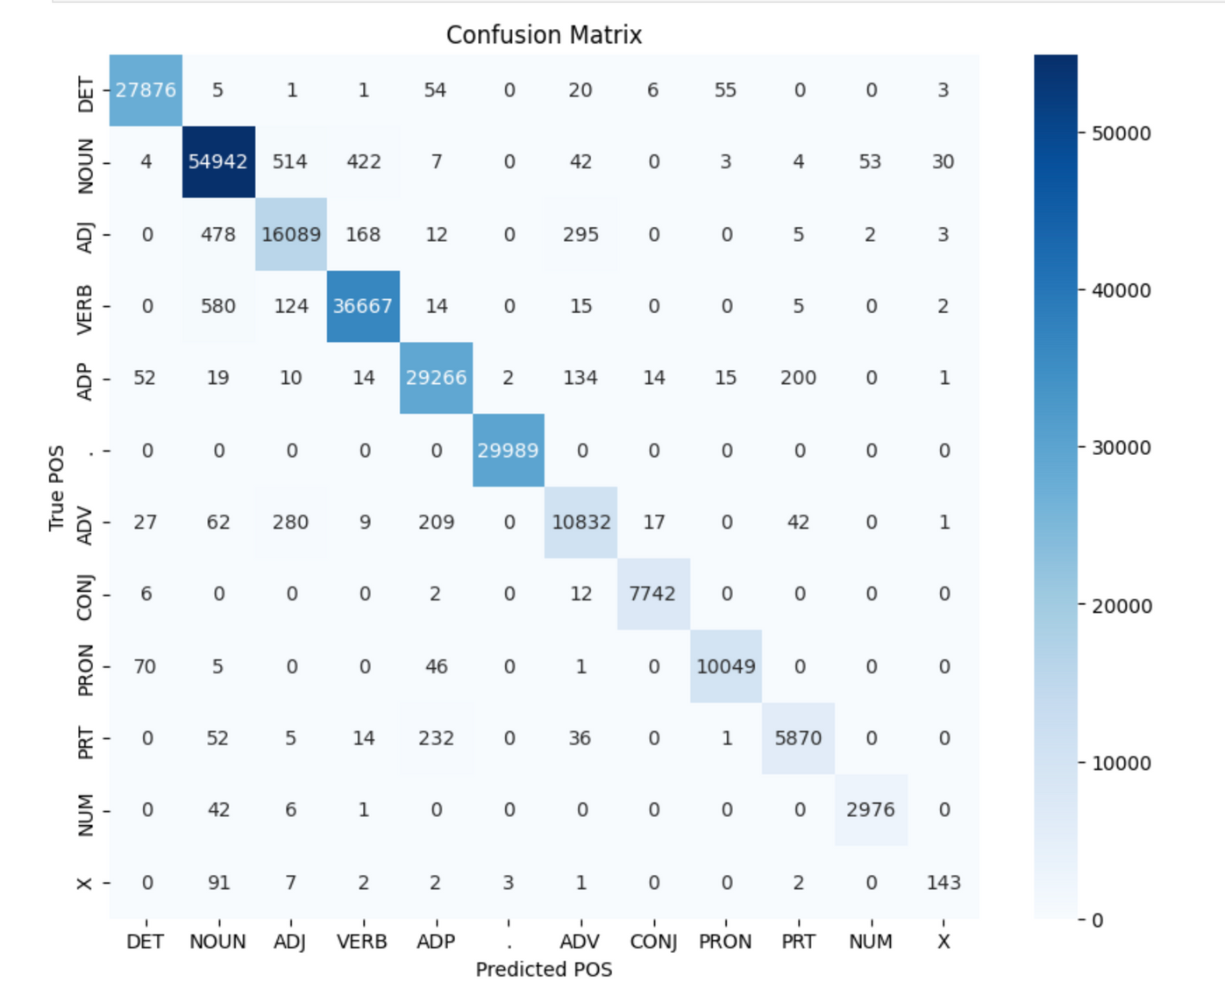
CONFUSION MATRIX

Slide 9

INTERPRETATION OF CONFUSION
The analysis of the confusion matrix reveals the following tags with their respective confusion counts:
• NOUN: Confused most frequently with ADJ (514 instances) and VERB (422 instances).
• ADJ: Primarily confused with NOUN (478 instances).
• VERB: Confused mainly with NOUN (580 instances).
• ADP: Confused with PRT (200 instances).
• DET: Confused with PRON (55 instances).
• PRON: Confused with DET (70 instances).
• ADV: Confused with ADJ (280 instances).
• PRT: Confused with ADP (232 instances).
• NUM: Confused with NOUN (42 instances).
• X: Confused with NOUN (91 instances).
• CONJ: Confused with ADV (12 instances).

Slide 10
INTERPRETATION OF CONFUSION
The analysis reveals that NOUN, ADJ, and VERB tags exhibit the most significant levels of confusion, particularly with each other. The tag NOUN was most often confused with ADJ, while VERB showed high confusion with NOUN.
Reasons for Confusions
1. NOUN and ADJ Confusion: This could be attributed to the syntactic structure of sentences, where adjectives frequently modify nouns, leading to potential misclassification.
2. VERB and NOUN Confusion: Verbs often appear in contexts that are similar to nouns, especially in cases where gerunds or nominalized verbs are present.
3. ADP and PRT Confusion: The distinction between adpositions (prepositions) and phrasal verbs (particles) can be subtle, especially in cases where the context does not clearly indicate their function.

Slide 11
Comparison with HMM
Sentence | HMM Output | CRF Output | Case
The sun shines bright. | bright: ADJ | bright: VERB | HMM Better
She sings beautifully. | beautifully: ADV | beautifully: VERB | HMM Better
Birds fly south. | south: NOUN | south: VERB | CRF Better
Dogs bark at night. | night: NOUN | night: DET | CRF Better
He ate lunch. | ate: VERB lunch: NOUN | ate: VERB lunch: NOUN | Both Same
They danced all night. | danced: VERB all: PRT night: NOUN | danced: VERB all: PRT night: NOUN | Both Same

Slide 12
Comparison with HMM
HMM relies on transition probabilities between tags based on sequences, which works well for simpler, more predictable sentences. "Bright" is commonly an adjective following "shines," so HMM correctly captures this. CRF, which relies on feature dependencies, might incorrectly classify "bright" based on its position in other contexts where "bright" could be a verb. CRF is better at handling context-specific patterns and features. In this sentence, "south" is an action (flying south), which CRF correctly tags as a verb. HMM likely misclassifies it based on the fact that "south" is commonly a noun, such as when used geographically, missing the context of direction.

Slide 13
REFERENCE
https://www.cs.columbia.edu/~jebara/6772/papers/crf.pdf
https://aclanthology.org/N03-1028/
https://medium.com/the-modern-scientist/conditional-random-fields-for-part-of-speech-tagging-in-natural-language-processing-0f444133d455

Slide 14
Thank You
For your attention

